Slide 1
Large Scale Deep Learning using the High-Performance Computing Library OpenMPI and DeepSpeed
Jennifer Davis
November 3, 2022

Slide 2
Agenda
Review Parallel and Distributed Computing
How MPI Works
Starting your workspace and cloning the project
DeepSpeed Introduction
MPI + DeepSpeed
Jupyter Notebook Code Walk-throughs
We will alternate between 15-20 minutes of lecture and 10 minutes to practice in your notebooks.
Notes:
Explain cost savings via memory and hardware requirement reduced
Add anecdotal insights
More aware of how to converse in this area

Slide 3
What is Parallel Computing?
Type of computing in which many calculations or processes are carried out simultaneously on several nodes and threads within a CPU or GPU
Limits
Available Parallelism
Load Balancing
Managing communication between processes
Pros
Faster speeds for data processing and computations
Enabling Big Data and Machine Learning

Slide 4
What is Distributed Computing?
When multiple computers, CPUs or GPUs are used, tasks can be distributed among the cluster components unevenly and in parallel
First rule: Don’t distribute your workload on clusters unless you see a need to
Most deep learning and big data machine learning will be more performant on a distributed system
Reinforcement learning is computationally intense, so distributed computing is helpful
With very large models (e.g. GPT-2, Megatron)

Slide 5
MPI Overview
When an MPI program initiates, several processes gets created including processes that
runs on a node of a cluster,
has its own memory space,
and communicates with the other processes via MPI point-to-point and collective messaging capabilities.
Other things to know about MPI
complies on different operating systems (windows, linux, mac)
supports parallel computation, distributed memory and shared memory
each process has its own memory space and executes independently (i.e. one process can fail why others continue to run)
Overhead for processes occur only once
Notes:
MPI or message passaging interface, is a library that is often used in High Performance Computing. DeepSpeed, which we’ll discuss a little later on in our talk – is designed to use MPI and a algorithm (ZeRO or zero-redundancy optimization) to reduce mis-use or redundant memory usage. This enables higher-parameter models to be trained, and perform inference with smaller hardware. In some cases it makes training possible e.g. 100-Billion Parameter models, where normally it would not be possible.

Slide 6
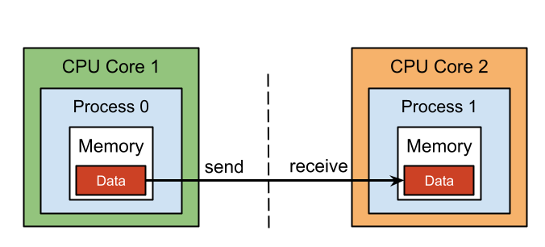
MPI Process Communication
Notes:
https://hpc.nmsu.edu/discovery/mpi/introduction/

Slide 7
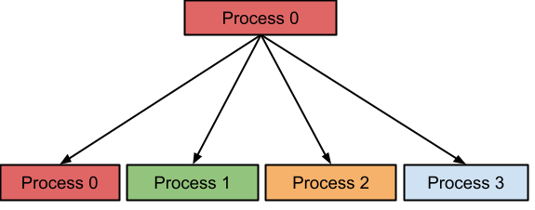
MPI Broadcast Distributions (Distributed Computing)
Notes:
https://hpc.nmsu.edu/discovery/mpi/introduction/
Notice head node / scheduler is also a worker
One process can fail while others continue
The broadcaster coordinates responses

Slide 8
MPI on Demand Use Cases
Parallel computation
Parallel File Systems
Communication / SuperPODs / High Performance Computing
Image Processing Example
Read jpg or png
Partition image into parts and distribute to worker processes
Collect results
Write results into a file

Slide 9
Steps to setting up a workspace for MPI
Name your workspace
Use a name you will remember that indicates whether it is distributed or not and the type of tool used (i.e., in this case MPI, DeepSpeed)
Choose your workspace environment
Ensure your datasets are available
Choose your scheduler and compute hardware tier (suggest GPUs as use of CPUs will involve more code modification)
Choose the number of workers

Slide 10
Cluster Environments on Domino
When using on-demand Clusters in Domino you will have two separate environments:
One for the workspace/job
One for the cluster workers/executors
We will do a walk-through of how to sign-up, clone the project and start your workspace
Our Teaching Assistants are available if you have trouble signing up for Domino Access, cloning your project or starting your workspace
Make sure to only use 1 GPU for your cluster

Slide 11
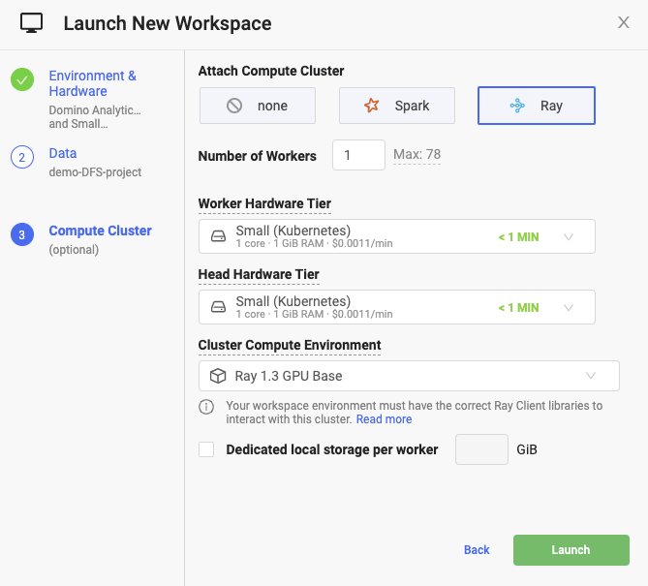
Cluster Settings
Select the Attach Cluster option
Set the number of Workers/Executors to 1, and hardware tiers for each to GPU
Dedicated local storage will be mounted to /tmp and de-provisioned when the cluster is shut down
Suggest setting the dedicated local storage to 100 GB as you will be downloading a computer vision dataset
Notes:
Available only to local execution

Slide 12
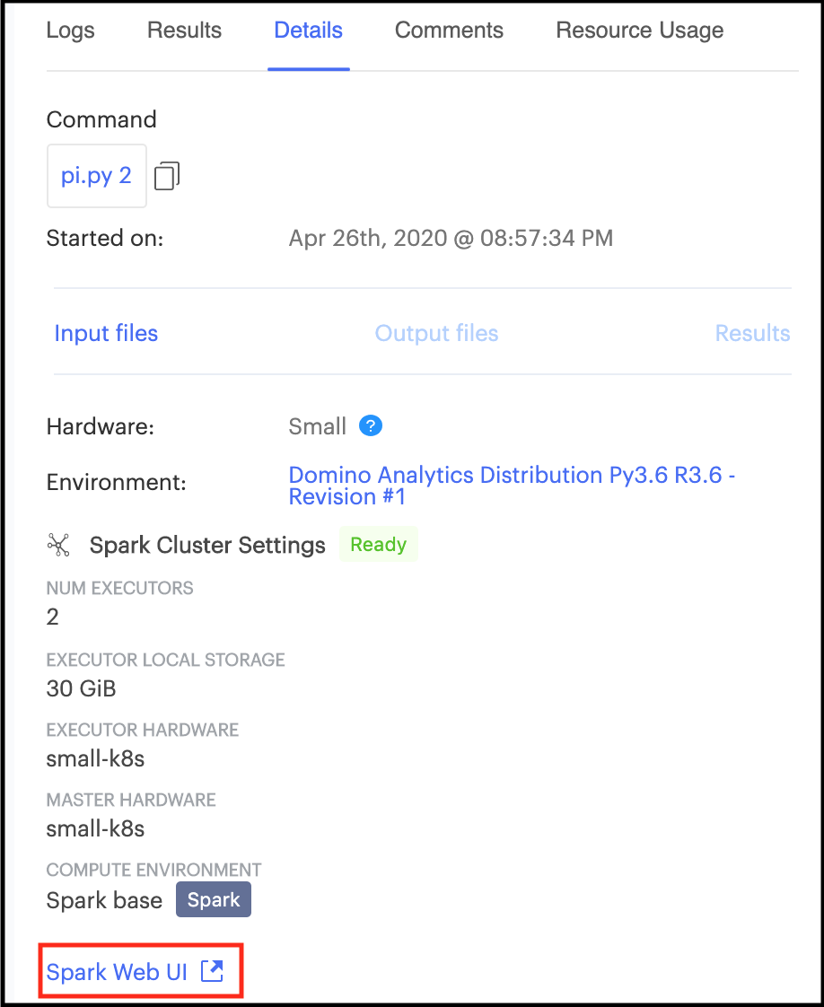
Other ways to Run Distributed Compute: Batch Jobs
Set up the cluster when running a Job from the quick-action, files page, or Job dashboard
MPI clusters do not have the an user interface as Spark, Ray and Dask do
Currently only tested with Jupyter Lab and VSCode
Notes:
Do not store data in local storage that needs to be available after workspace

Slide 13
Setting up your workspace

Slide 14
MPI Examples (Parallelism vs. Distributed): Calculating Pi
MPI distributes a computation using a message passing interface and shared memory
We will calculate Pi two ways using MPI (two separate files for submission to the cluster)
How the code is written matters: calculates pi more quickly if run in distributed mode rather than simple parallelism

Slide 15
Calculating Pi: A Hello World Example for Distributed Computing
The number pi is a ratio obtained from defining the area with a circle. If the diameter and the circumference of a circle are known, the value of pi will be as π = circumference of a circle/diameter of a circle.
We can take several samples from the calculations of pi and reduce them to a final number in order to estimate pi more closely
For this example we will use the Leibniz formula (which is easily distributed) and which you can find out more about it here.

Slide 16
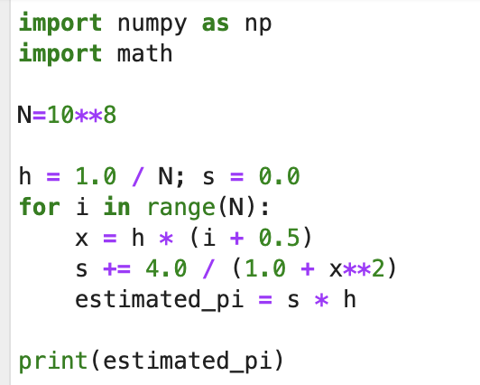
Calculate Pi Using Leibniz Method with and without MPI
First we will submit the code file ‘as-is’ and time it
Next we will submit the code ‘as-is’ to the cluster
Notice whether we are using simple parallelism or running in a distributed mode
What differences do you see

Slide 17
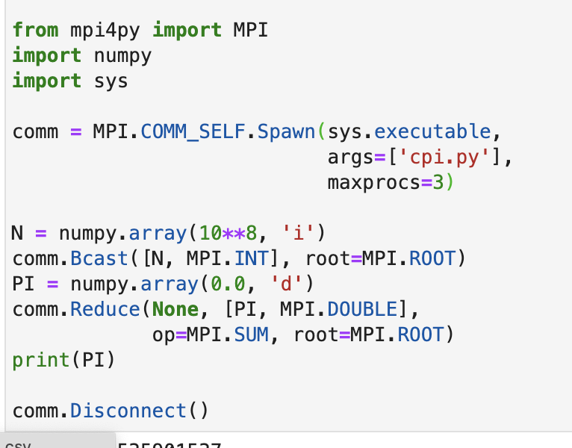
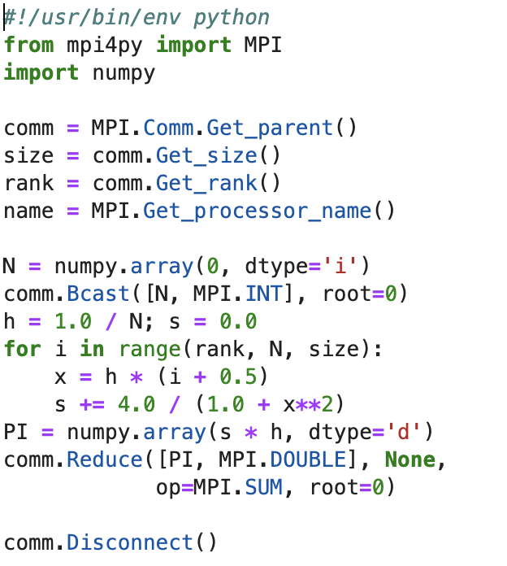
Hello World Example to Calculate Pi with Large Numbers in a Distributed Fashion

Slide 18
MPI Distributed Code Does the Following
Broadcasts the Numpy points across workers
Collects calculations from the workers
Reduces the answer to a final approximation of pi
Let’s take a look at our notebook tutorial to learn more

Slide 19
Jupyter Notebook Walk-through: Calculate Pi
Notes:
Alternate between code and examples in slides highlighting functions.

Slide 20
What is DeepSpeed?
“DeepSpeed is a deep learning optimization library that makes distributed training easy, efficient, and effective. 10x Larger Models | 10x Faster Training | Minimal Code Change.” - Microsoft
DeepSpeed is a distributed computing engine which acts as a wrapper around pytorch neural network models and includes check-pointing
DeepSpeed contains:
ZeRO Optimizations,
Scheduler
Autotuning, optimizers
Is appropriate for quantized models as well as massive, trained models such as GPT-2 and Megatron
DeepSpeed uses MPI to distribute, broadcast and employ workers

Slide 21
Why use a MPI Cluster with DeepSpeed?
Larger datasets
Massive Models
Efficient scheduling by DeepSpeed on MPI
Load balancing by DeepSpeed on MPI
Faster computation times

Slide 22
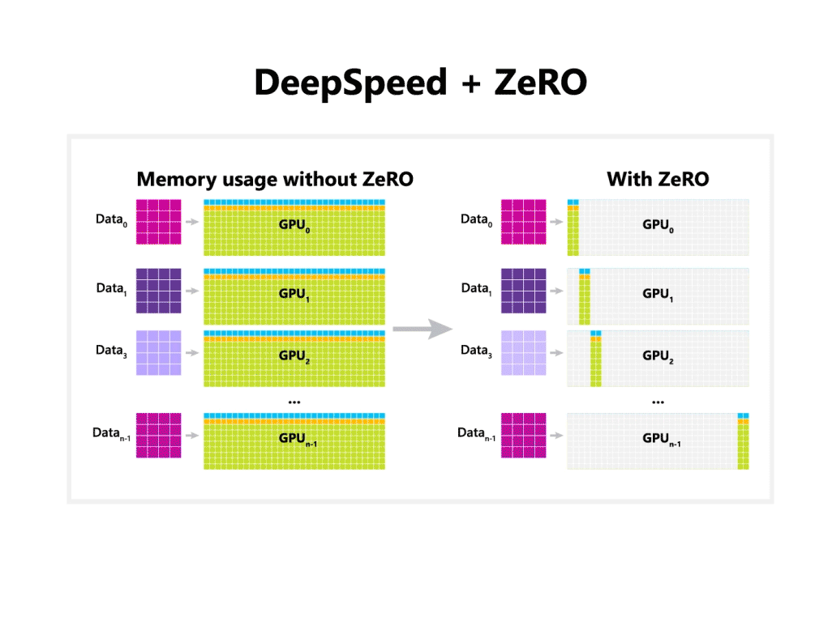
Notes:
credit Microsoft blog here: https://www.microsoft.com/en-us/research/blog/zero-deepspeed-new-system-optimizations-enable-training-models-with-over-100-billion-parameters/

Slide 23
DeepSpeed Use Cases
Training massive models using transfer learning or from scratch (GPT-2, Megatron)
Inference on massive models (e.g. forward propagations)
Native use of Quantized of Models
Hypermeter Tuning

Slide 24
How DeepSpeed Integrates into the AI Science Lifecycle
Model Development in Pytorch, Pytorch Lightning or Transformers
Model Training – use DeepSpeed for scaling and speeding up training to reasonable times, can use billions of parameters for training
Model Inference – use DeepSpeed forward propagation from a trained model to infer outputs

Slide 25
Standard Transformers and DeepSpeed+Transformers
Transformers Library:
Python library of language models
Built on Pytorch
Models are made to train on single GPU or CPU
High memory requirements for most models, so hardware may be more expensive
DeepSpeed + Transformers Library:
Python library which optimizing training using MPI and the ZeRO training formulas based on Distributed Data Parallel
Built to complement Pytorch and integrates tightly with transformers library and pytorch lightning
Built to run on MPI so can use cluster to share data load
Speeds up most calculations significantly
Can handle larger parameter models without TPU requirements

Slide 26
Overview of DeepSpeed Functions: Training Set-up
See all training functions in deepspeed by going to documentation DeepSpeed Training Initialization
Highlights / Gotcha’s:
deepspeed.initialize – initialize arguments for training parameters, models etc. Does not automatically run training on a cluster!
deepspeed.init_distributed – looks for pytorch backend (remember we set the back-end in our code), and can perform MPI discovery
--hostfile should be used to provide the MPI host file doc

Slide 27
Overview of DeepSpeed Functions: Inference Set-up
See all the functions in deepspeed by typing DeepSpeed Inference Engine
Highlights / Gotcha’s:
deepspeed.init_inferences– initializes DeepSpeed inference engine
deepspeed.InferenceEngine.forward– implements forward propogation
--hostfile should be used to provide the MPI host file doc

Slide 28
Examples in the Second Tutorial
Workshop Examples
Inference to summarize text using DeepSpeed
Inference to translate text to French using DeepSpeed
Supplemental – these take too long to run but you can try them after the workshop
Training a model to summarize news articles using CNN/Daily Mail dataset
Training a model to recognize protein sequences and conformations
Will show output but we will not run during the workshop

Slide 29
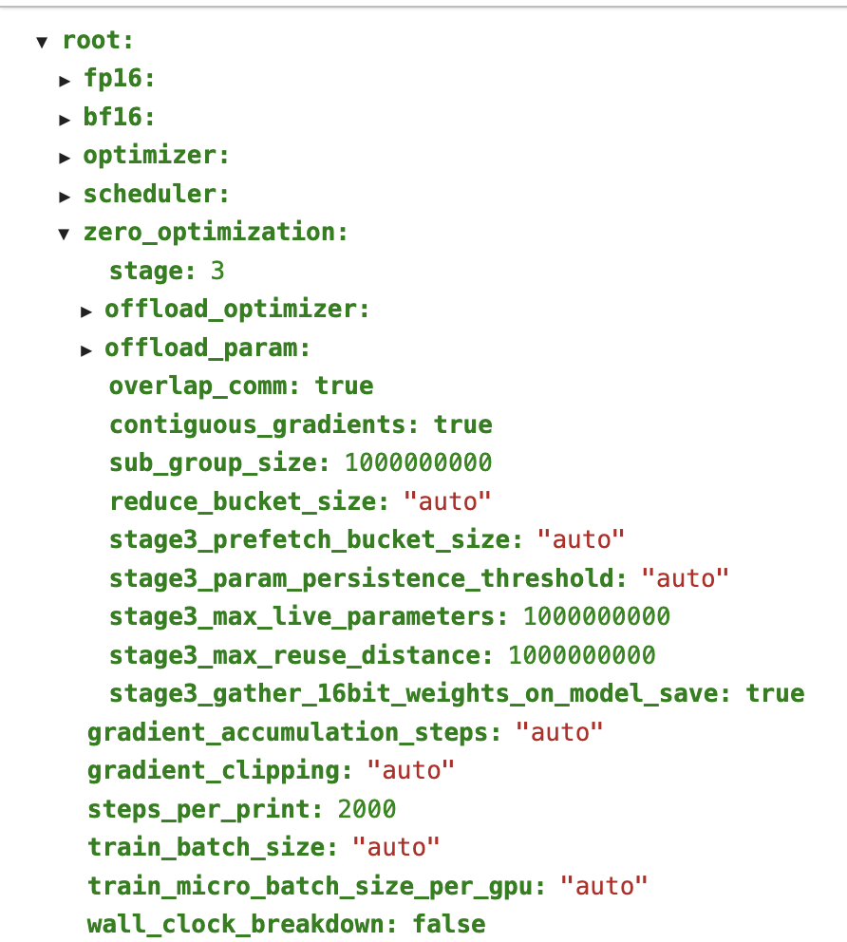
DeepSpeed Configuration Files and Auto-Tuning
Basic Parameters
Stage 3 ZeRO Training
Can fine-tune
fp16
bf16
scheduler
optimizer

Slide 30
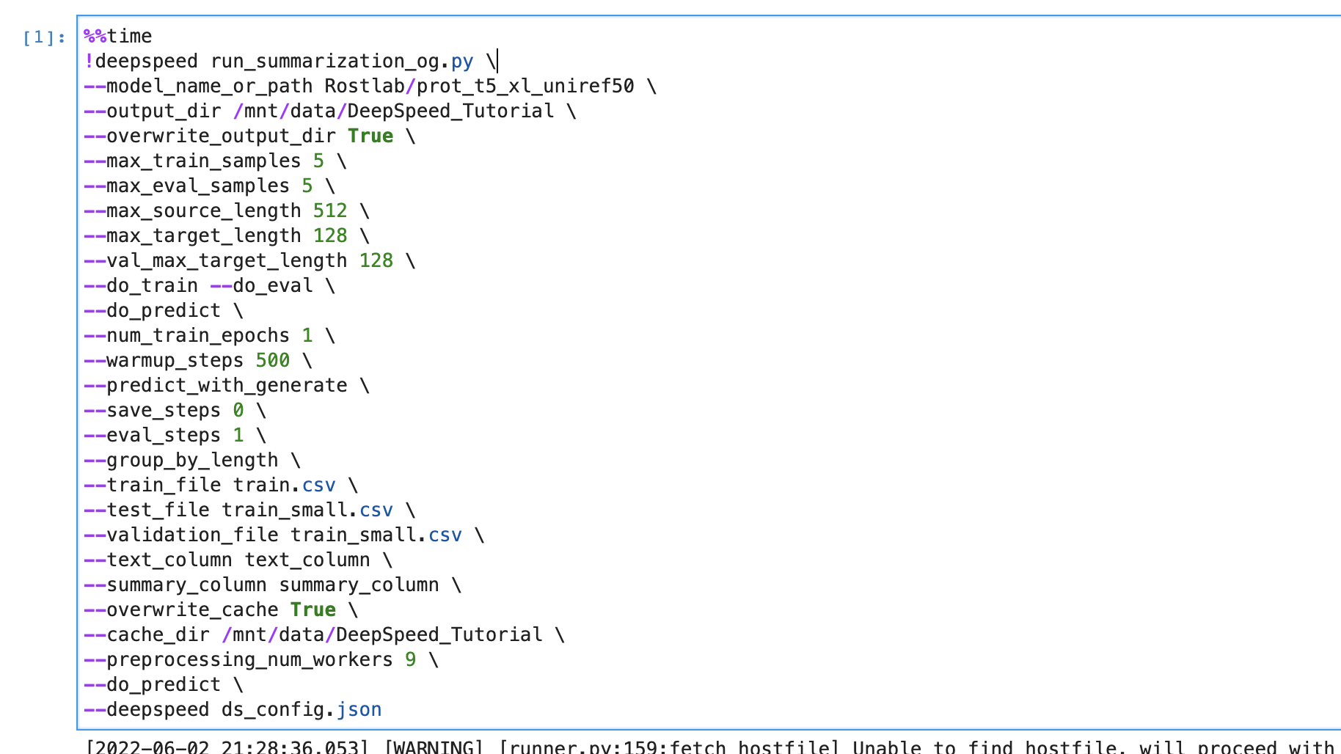
Proteomics Example: 8 minutes to do Transfer Learning a Massive Model (>2 Billion parameters)

Slide 31
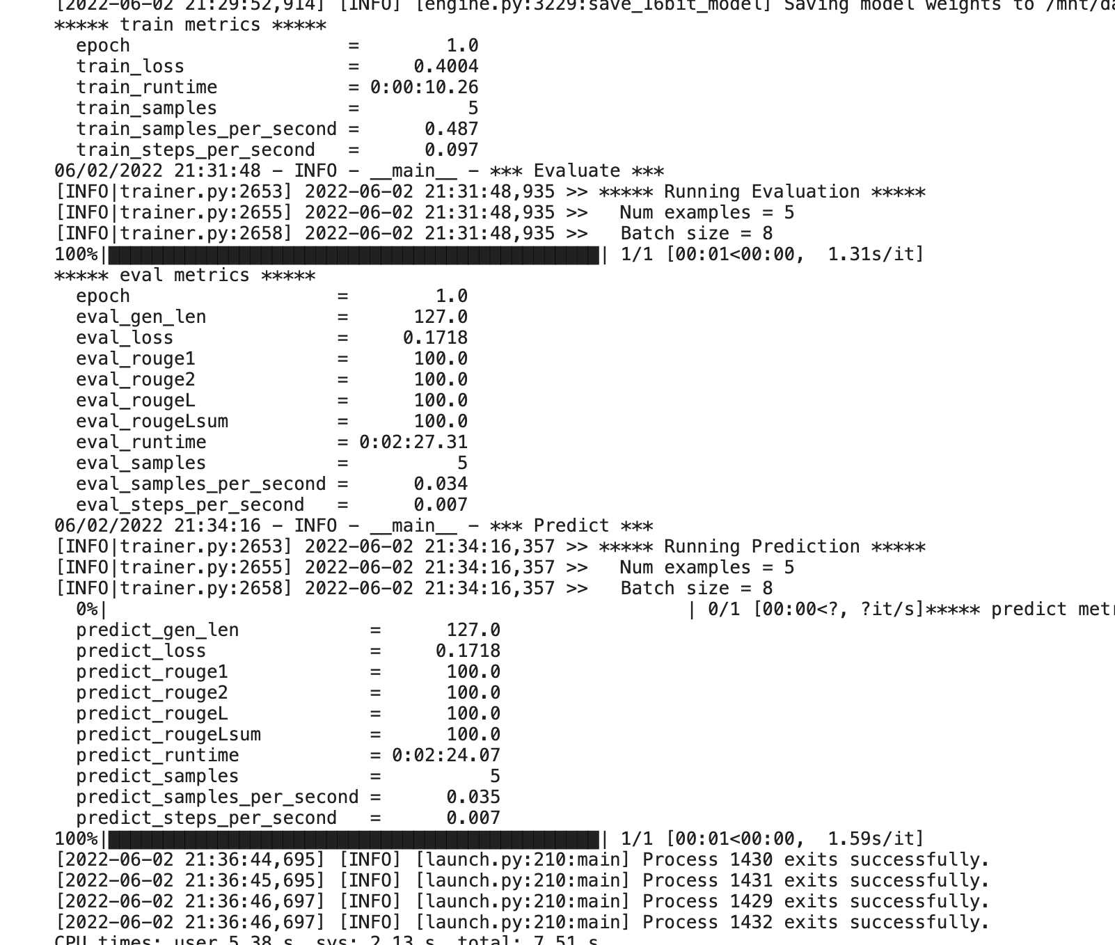
Proteomics Example: Transfer Learning a Massive Model Output

Slide 32
Intermediate Tutorial: Code Walk-through

Slide 33
Computer Vision Example: Zero Redundancy Optimization Advantages
Optimizes memory while improving speed of training very large models (100 Billion + parameters)
Allows scaling on GPUs with high computational granularity and efficiency
Original analysis on memory and communication volume suggested DeepSpeed can scale models beyond 1 Trillion parameters on available GPUs

Slide 34
Advanced Tutorial: Computer Vision Example
Explore using DeepSpeed to perform training and inference on the CIFAR dataset
Explore running DeepSpeed code on MPI versus the DeepSpeed framework
Explore the output of our CIFAR example
Demonstrate DeepSpeed on ZeRO, ZeRO2 and ZeRO3 algorithms

Slide 35
Advanced Tutorial: Code Walk-through

Slide 36

Field Data Science Practice
Assists at all phases of the project
Ideation
Research and development
Execution
Expert data scientists and field engineers help you leverage Domino for success
Dedicated team of field data scientists and data engineers focus on your success
We provide consultation services:
Best practices for data science on Domino
Developing Proof of Concepts and Minimum Viable Products
Execution of complex projects to solve business problems
Knowledge transfer upon project completion
Notes:
This is a list of what services the Field Data Science Practice offers:

Slide 37





FDS and FE Team
Josh Poduska, Chief Field Data Scientist
Melanie Veale, Field Data Scientist
Odette Harary, Field Data Scientist
Jennifer Davis, Staff Field Data Scientist
Deepika Vadlamudi, Field Engineer

Slide 38
Thank you!
More questions or comments:
Jennifer Davis jennifer.davis@dominodatalab.com
jor LinkedIn:
https://www.linkedin.com/in/drjenniferdavis/

